Slide 1
Lego technic FRR-458 model
By Kyle Mays and Keegan Stanphill

Slide 2
Objectives
Create and model lego technic model ferrari 458
Create and organize a workable parts list
Create a schedule to ensure work stays on track
Find a universal set of common dimensions to ensure accurate fit up
Create small yet workable subassemblies to increase efficiency

Slide 3
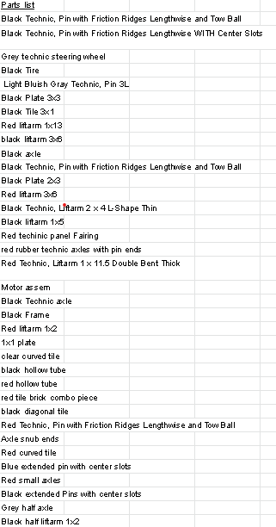
Parts list and organization
In order to ensure we had an accurate list of parts we needed to create we made a parts list in a common document shared between us. This ensured that there wouldn't be any duplicate parts. These parts were grouped by color, type of part, and dimensioning in the type of part

Slide 4
Scheduling
In order to stay on track, we created a simple week by week work schedule in our shared document. In this schedule, we each created different sub assemblies for each week of the project. Each sub assembly was color coded to show who was working on what

Slide 5
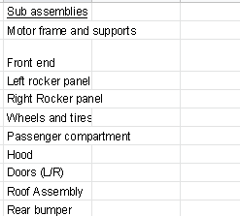
Subassembly creation
In order to successfully piece together the main assembly quickly and efficiency we divided the whole assembly into multiple sub assemblies. This was achieved by scrolling through the instruction manual and seeing how everything pieces together. From here we were able to successfully create easily created sub assemblies to reduce aggravation in creating the final assembly.

Slide 6
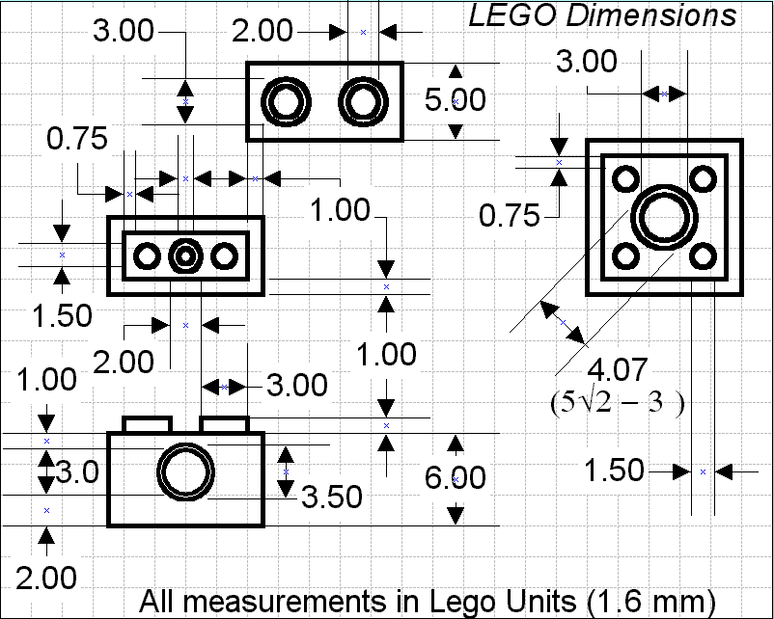
Common dimensioning scheme
In order to assure efficient assembly for the final assembly, We found common lego dimensions and the files were shared between the two of us respectively. This also helped us to exchange parts between the two of us for easy assembly in the sub and main assemblies.

Slide 7
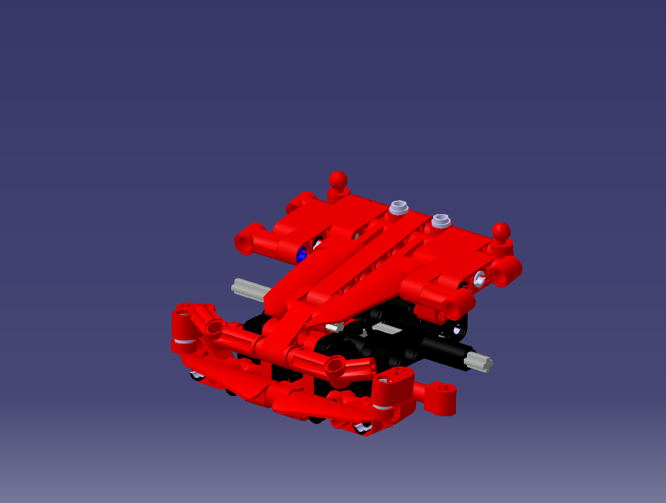
Sub Assembly Renders
Front bumper and hood assembly

Slide 8
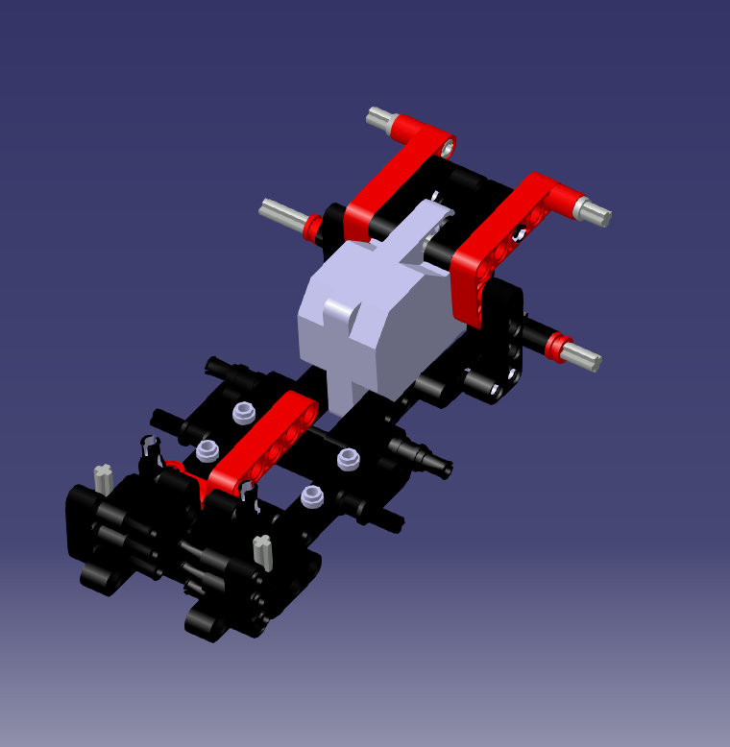
Main motor sub assembly

Slide 9
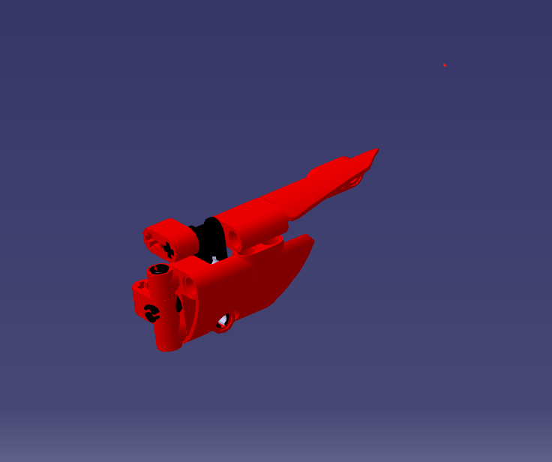
Doors

Slide 10
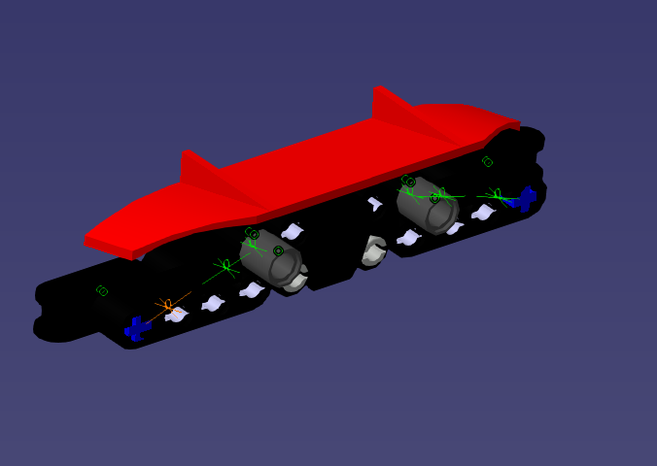
Rear bumper

Slide 11
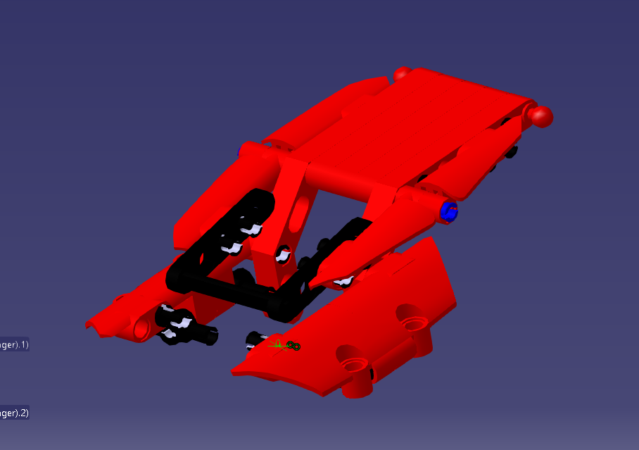
Roof

Slide 12
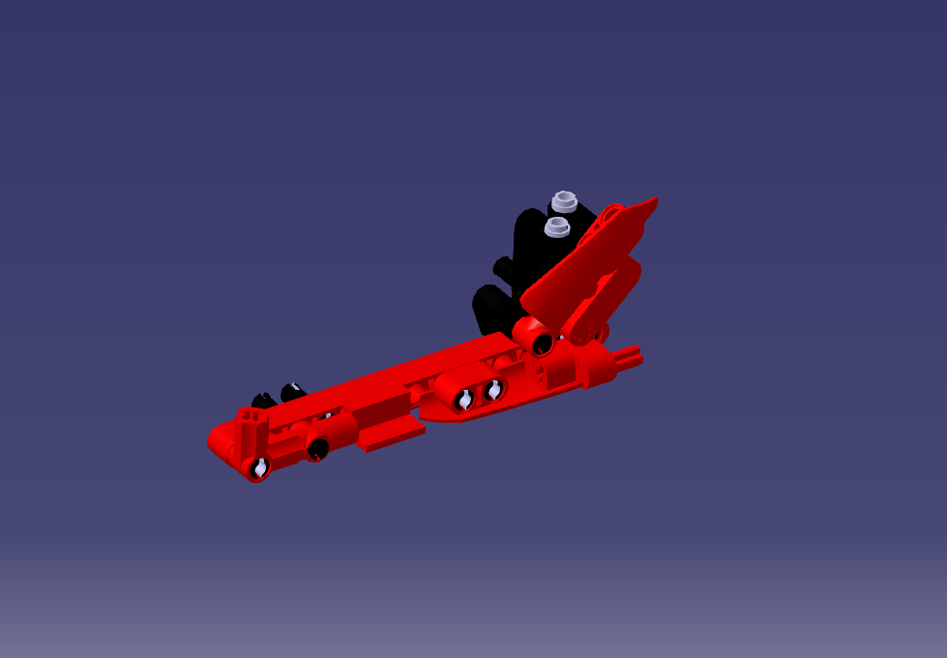
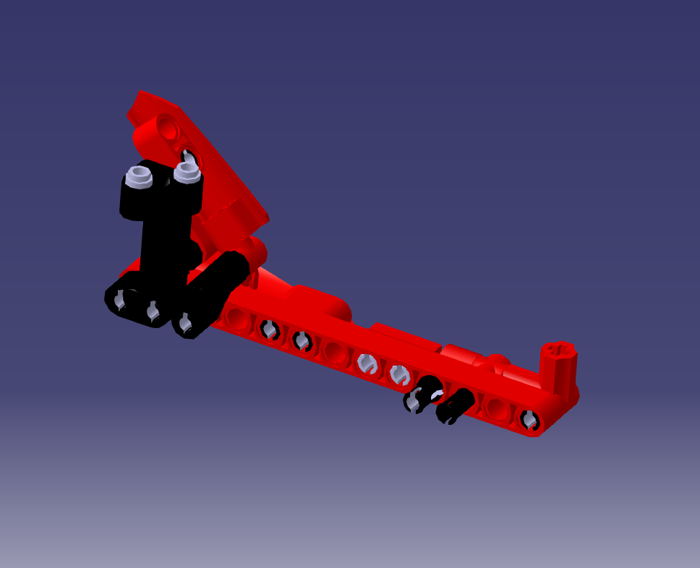
Rocker Panel

Slide 13
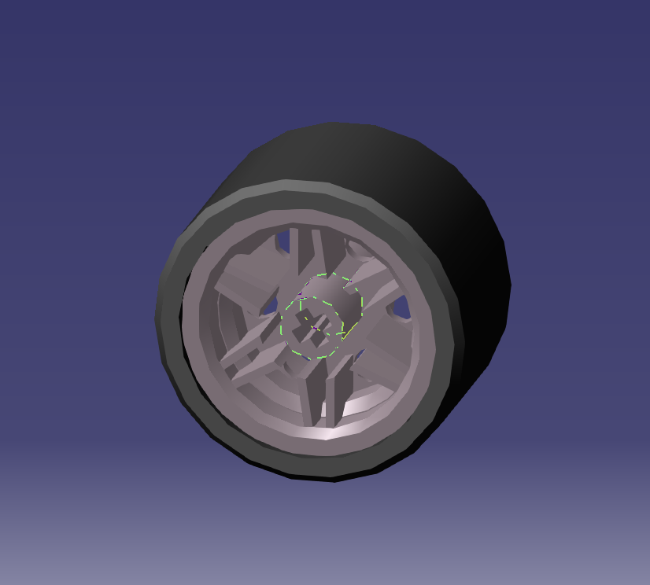
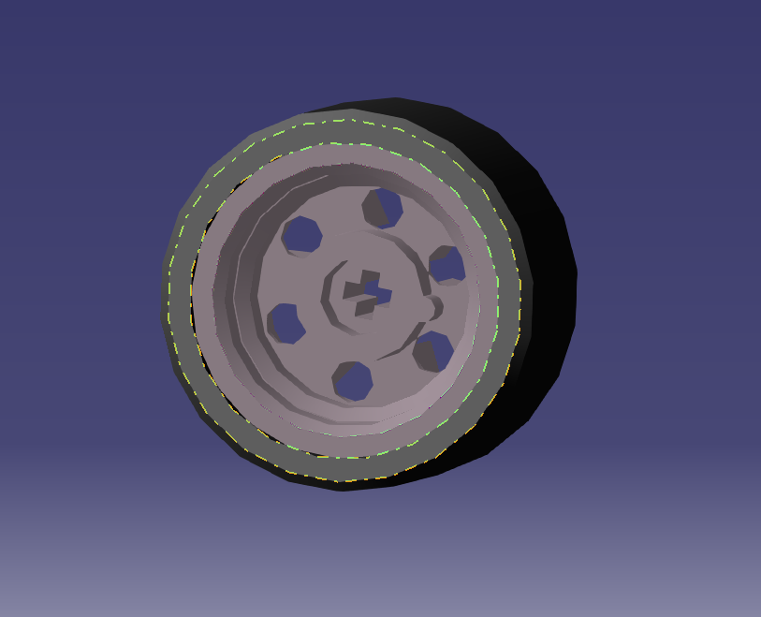
Wheels and Tires

Slide 14
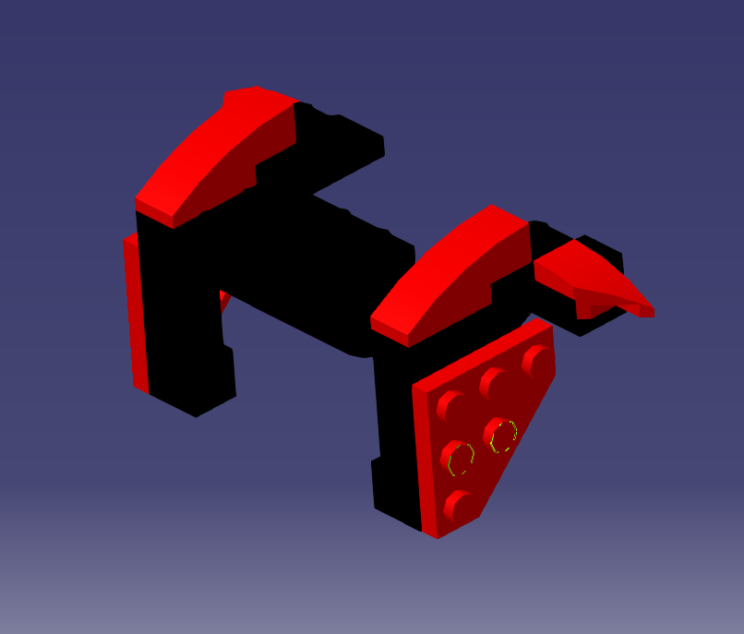
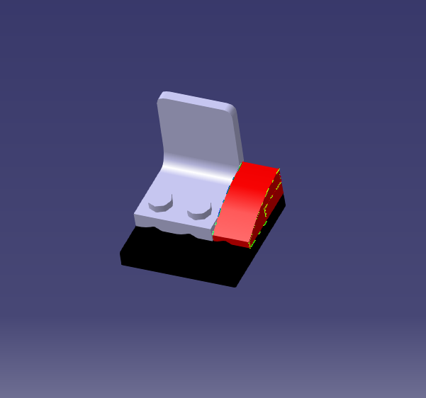
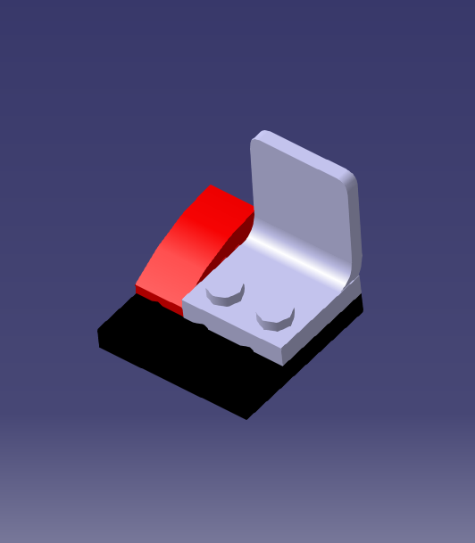
Passenger compartment

Slide 15
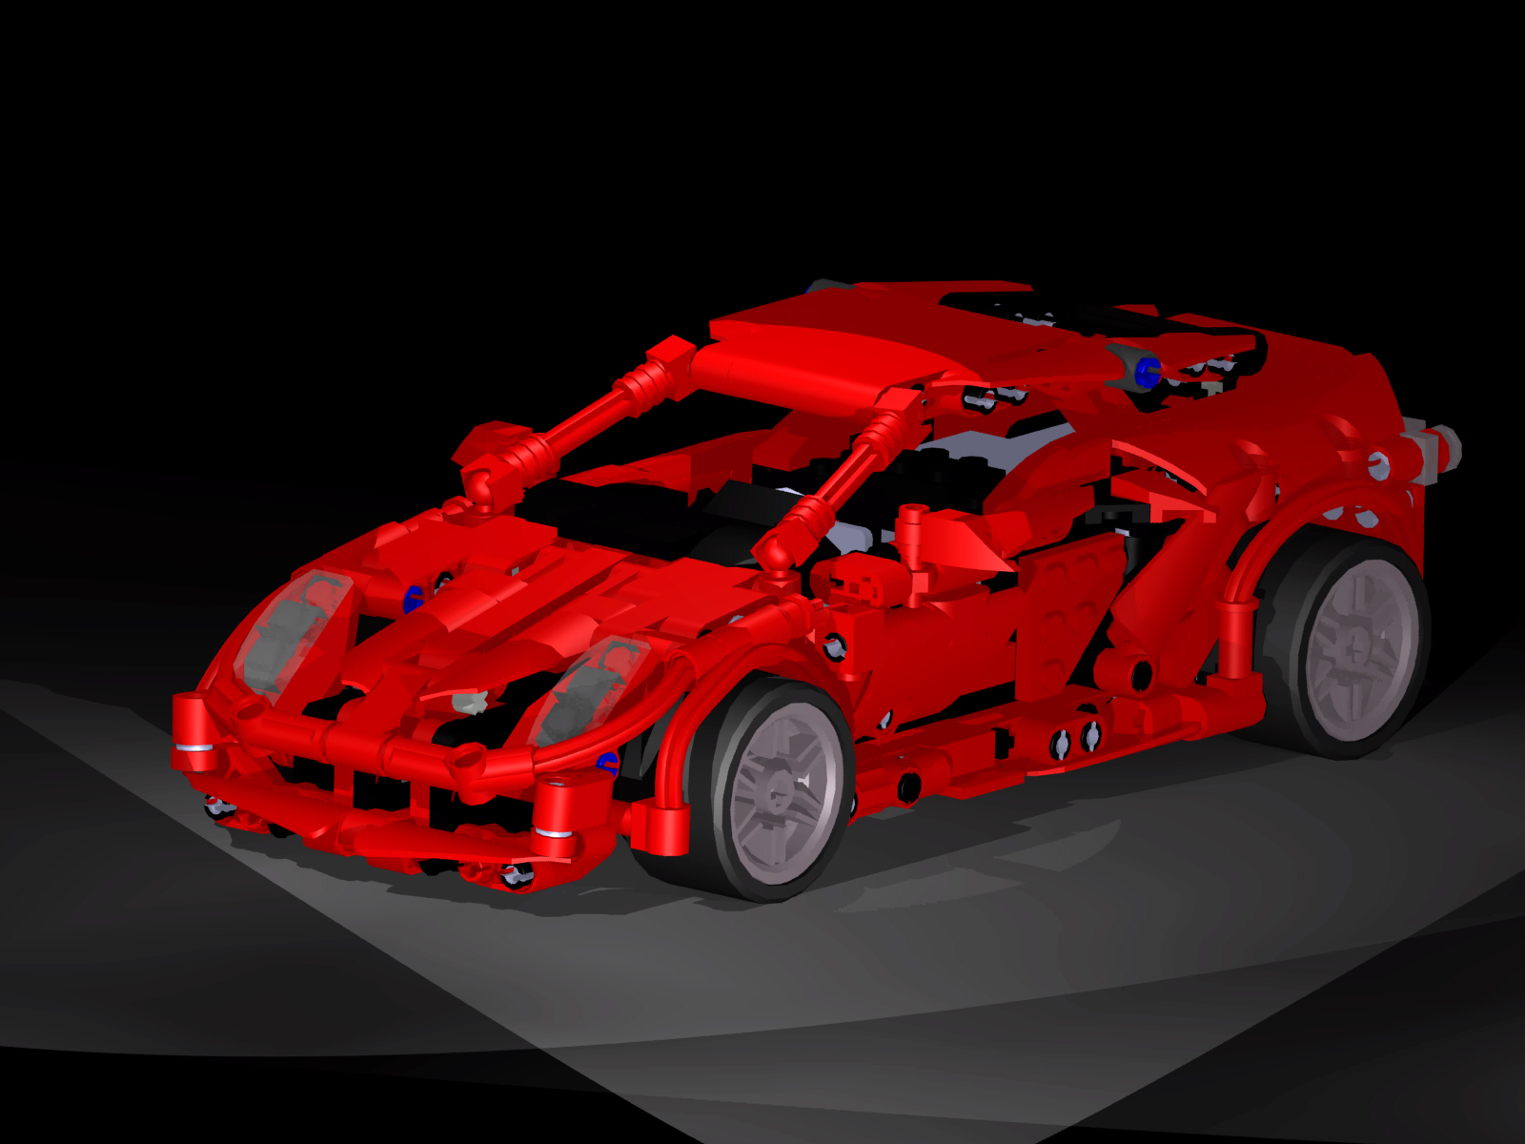
Final Render (isometric view)

Slide 16
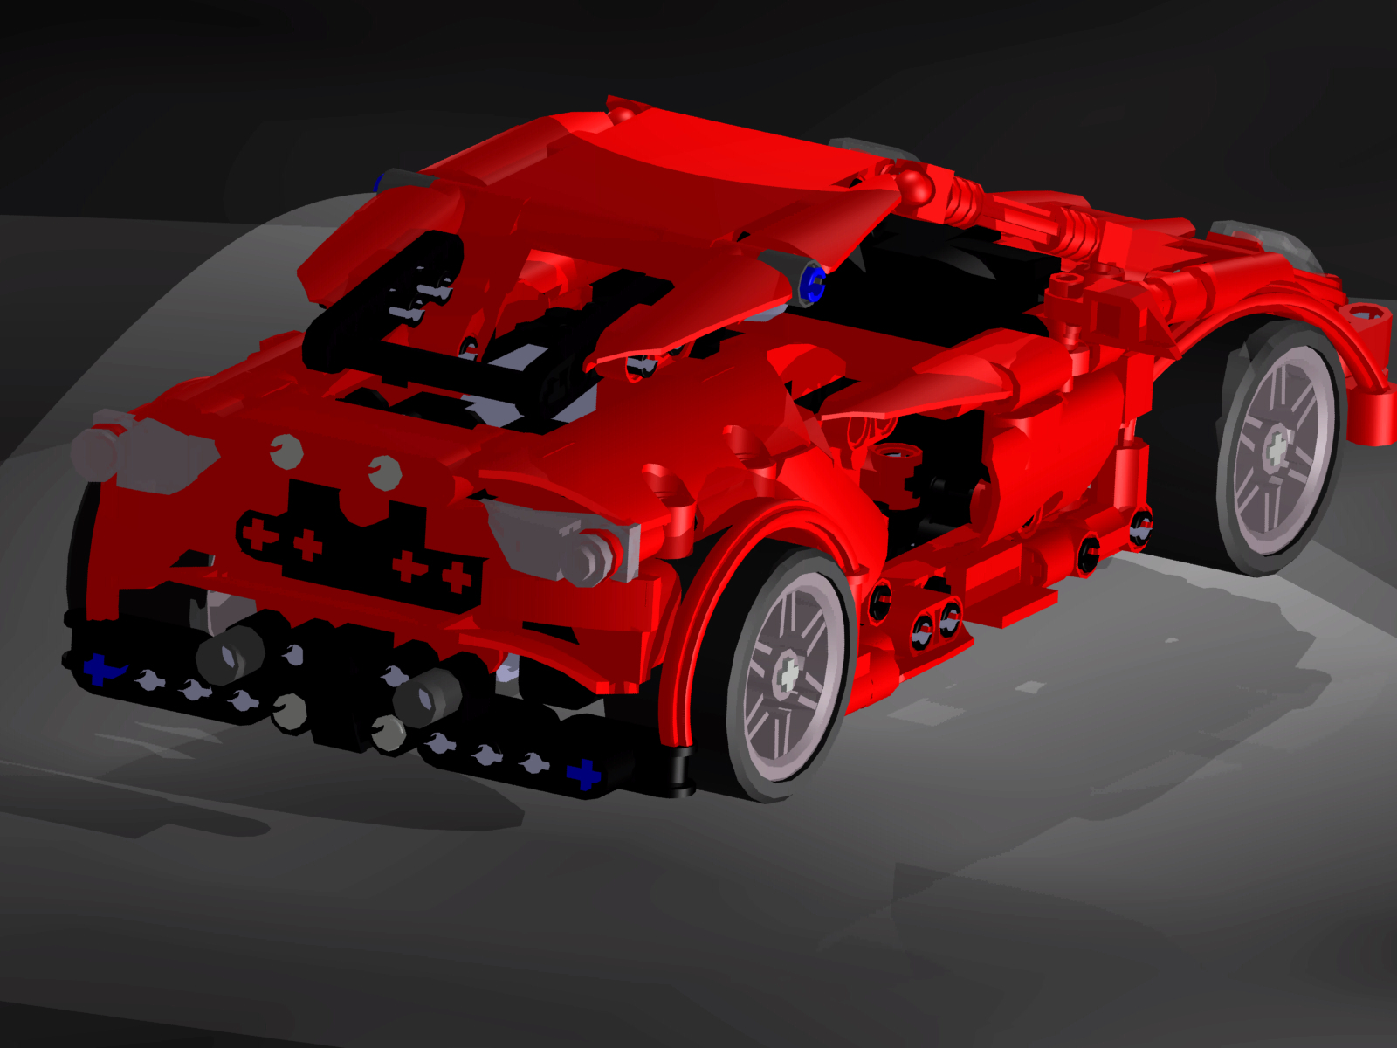
Final Render (Rear)

Slide 17
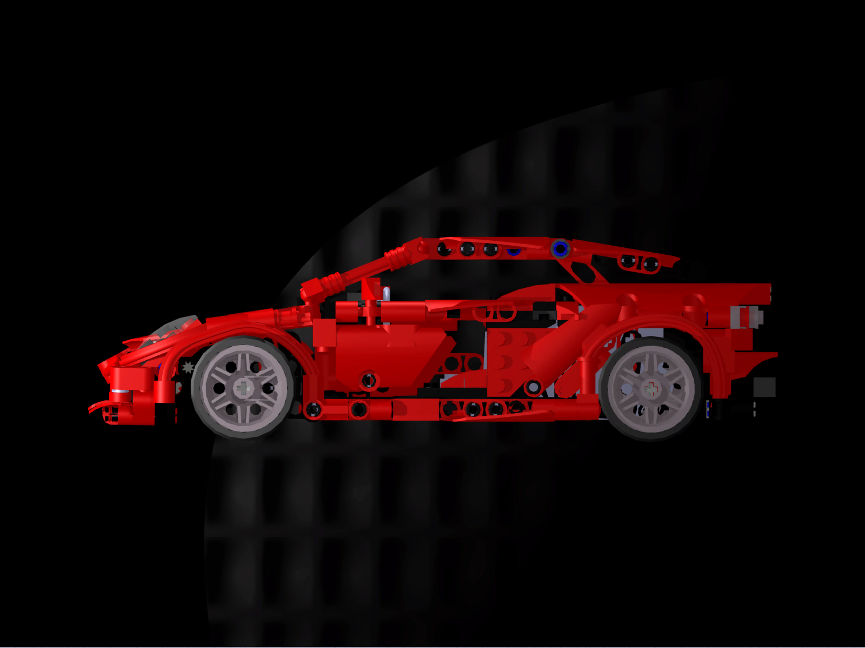
Final Render (Driver’s Side)

Slide 18
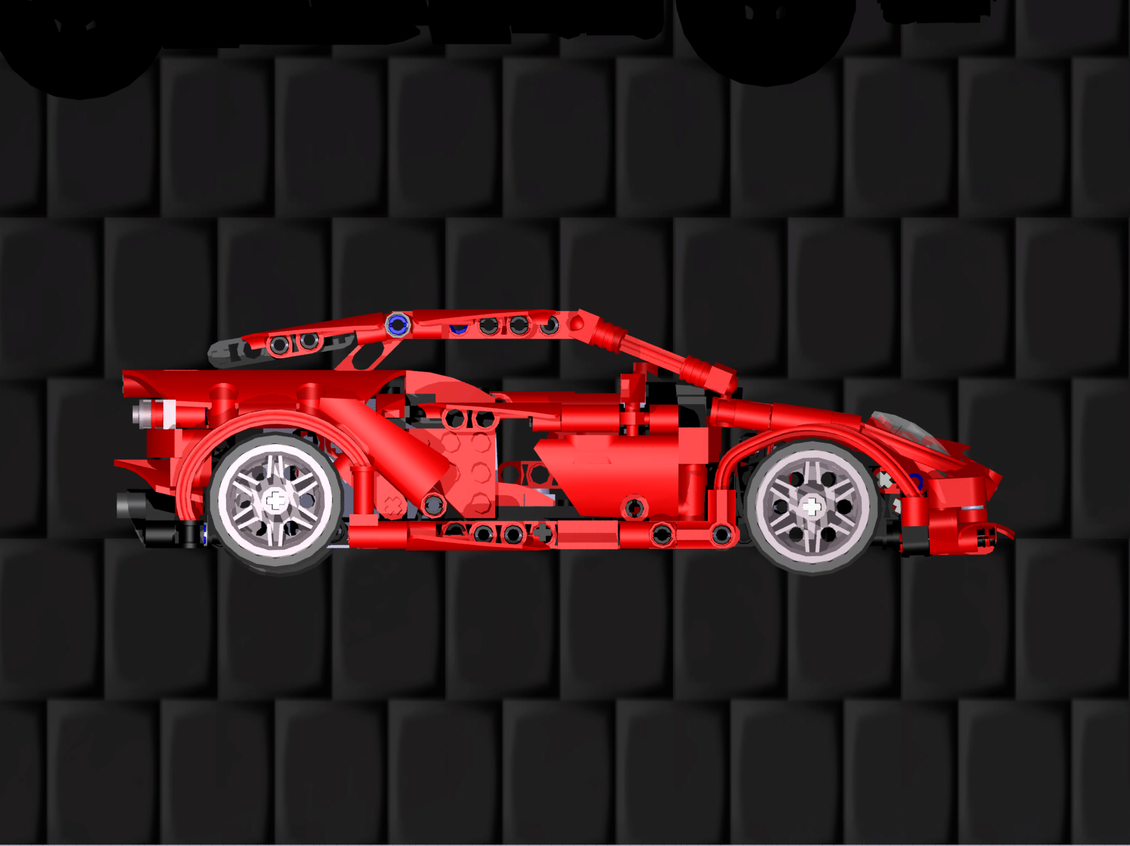
Final Render (passenger side)

Slide 19
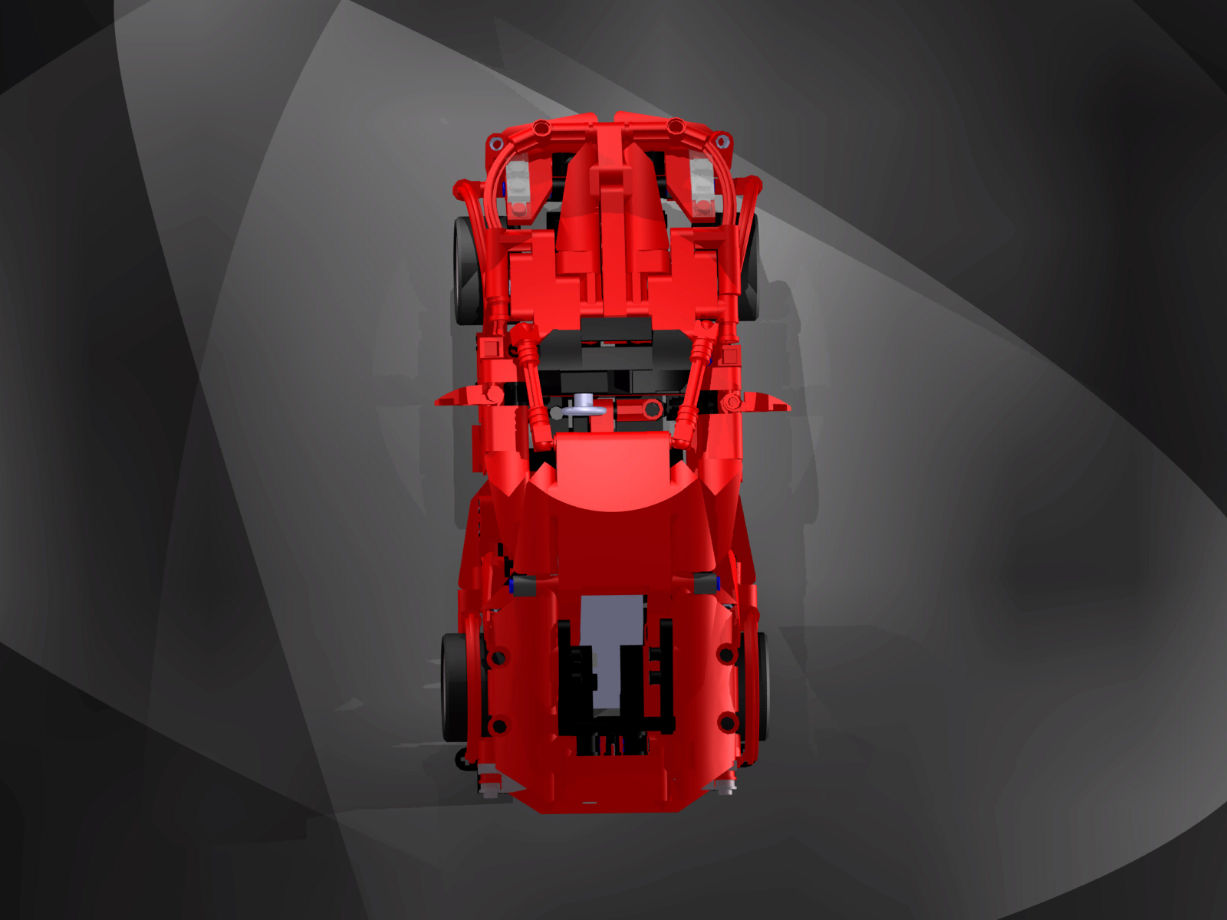
Final Render (Roof)

Slide 20
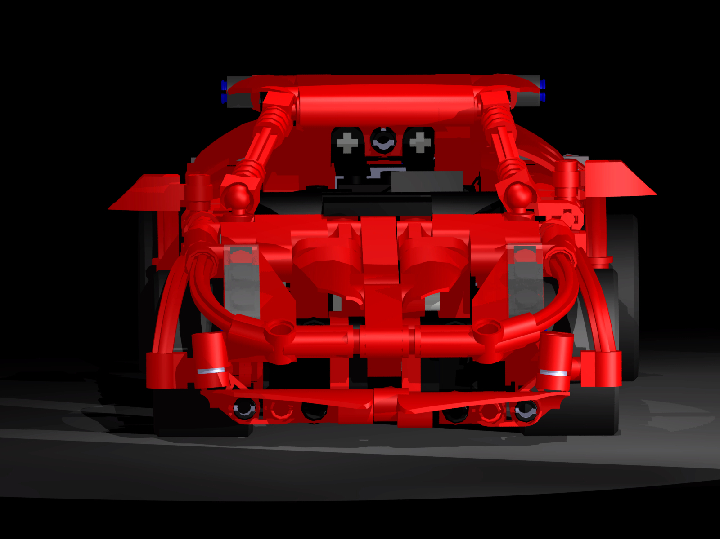
Final Render (Front)

Slide 21
Challenges and Struggles
In the creation of the model we did encounter some challenges with some aspects of the build. The first thing that we encountered was that our naming scheme was rather vague on some parts and we spent a lot of time finding parts.
Another challenge that we encountered was the Creation of some of the flexible parts that wrap around the wheel. Those parts had to be created in the assembly through a series of planes, points, and splines.
The last issue we had was the Shear size of the final assembly. This caused us lots of time in opening and modifying the final assembly.

Slide 22
Final Reflection
Overall we enjoyed working on the project. There were a lot of parts that were hard to manufacture in Catia but eventually we were able to figure it out. One thing that we would change in the future would be to improve our time management. In both of our cases we would complete the minimum for each week and it left us kinda stressed in the end. Overall however we think that the project went rather well all things considered.

